Slide 1
AI Techniques
Artificial Intelligence research during the last three decades has concluded that Intelligence requires knowledge.
To compensate overwhelming quality, knowledge possesses less desirable properties
It is huge.
It is difficult to characterize correctly.
It is constantly varying.
It differs from data by being organized in a way that corresponds to its application.
It is complicated.

Slide 2
AI Techniques
There are three important AI techniques:
1.Search –
Provides a way of solving problems for which no direct approach is available.
It also provides a framework into which any direct techniques that are available can be embedded.
2.Use of knowledge –
Provides a way of solving complex problems by exploiting the structure of the objects that are involved.
3.Abstraction –
Provides a way of separating important features and variations from many unimportant ones that would
otherwise overwhelm any process.

Slide 3
AI Techniques
An AI technique is a method that exploits knowledge that is represented so that:
The knowledge captures generalizations that share properties, are grouped together, rather than being allowed separate representation.
It can be understood by people who must provide it—even though for many programs bulk of the data comes automatically from readings.
In many AI domains, how the people understand the same people must supply the knowledge to a program.
It can be easily modified to correct errors and reflect changes in real conditions.
It can be widely used even if it is incomplete or inaccurate.
It can be used to help overcome its own sheer bulk by helping to narrow the range of possibilities that must be usually considered.

Slide 4
AI Techniques
In order to characterize an AI technique
let us consider initially OXO or tic-tac-toe and use a series of different approaches to play the game. The programs increase in complexity, their use of generalizations, the clarity of their knowledge and the extensibility of their approach.
In this way they move towards being representations of AI techniques

Slide 5
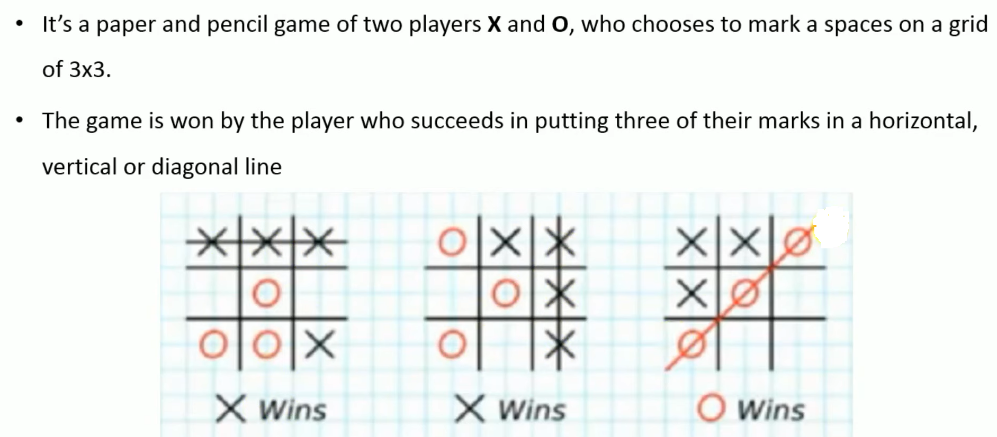
TIC-TAC-TOE GAME PALYING

Slide 6
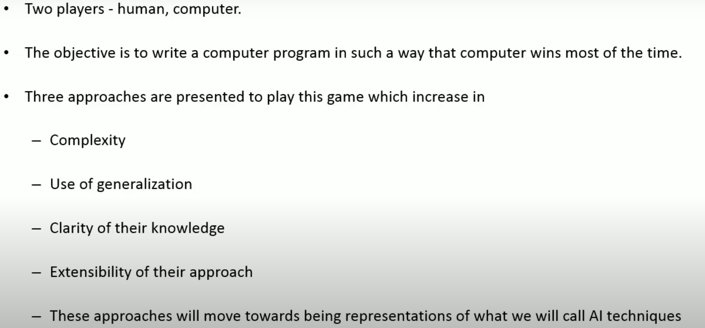
TIC-TAC-TOE GAME PALYING

Slide 7
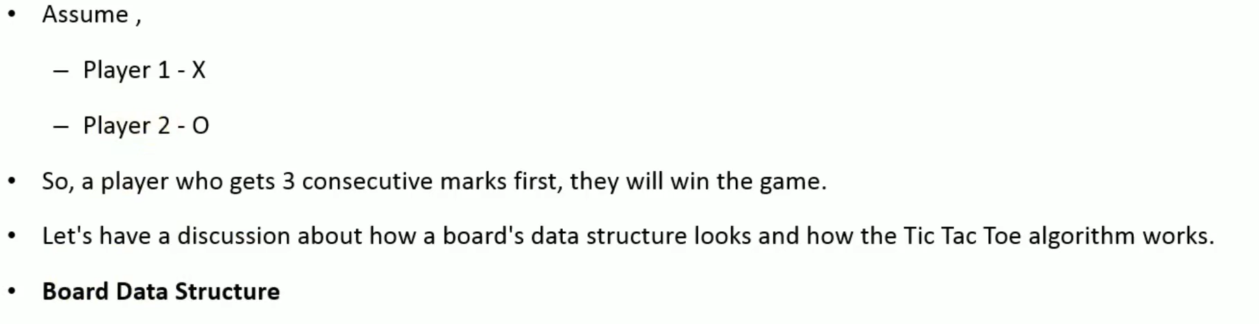
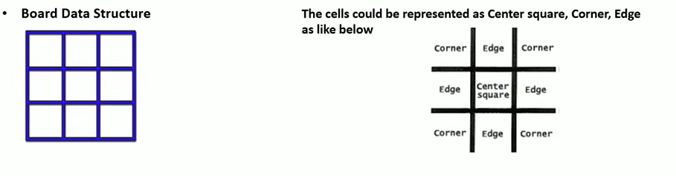
TIC-TAC-TOE GAME PALYING

Slide 8
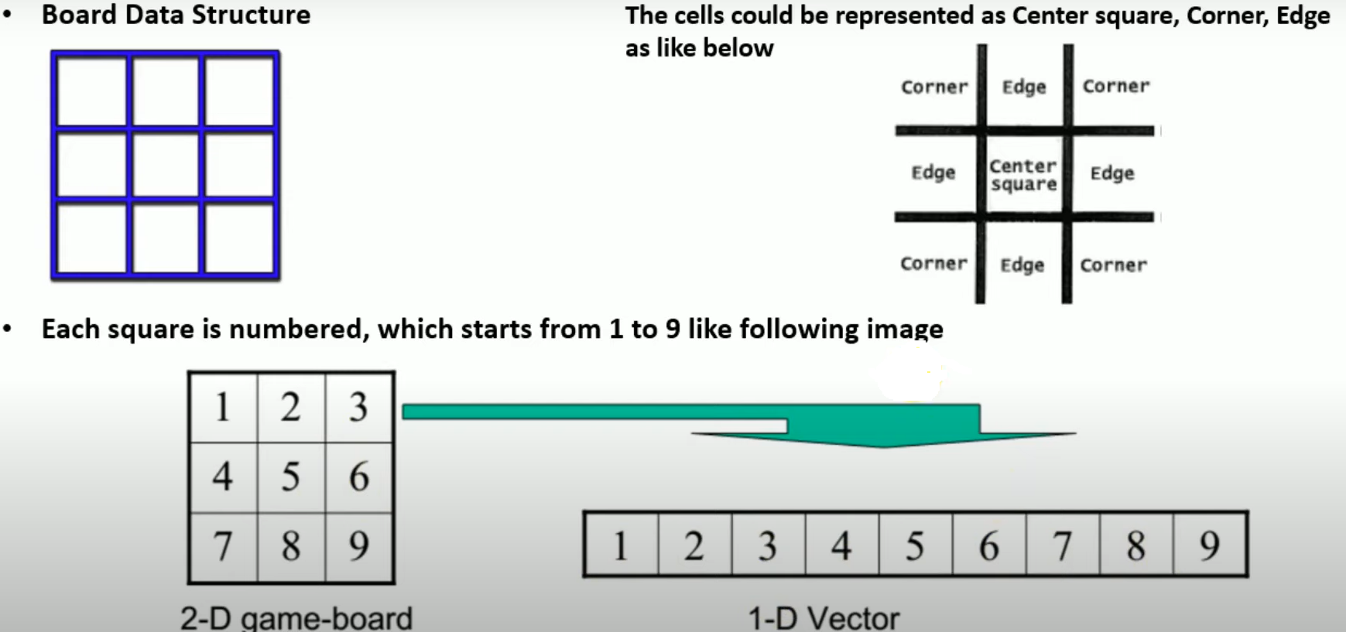
TIC-TAC-TOE GAME PALYING

Slide 9
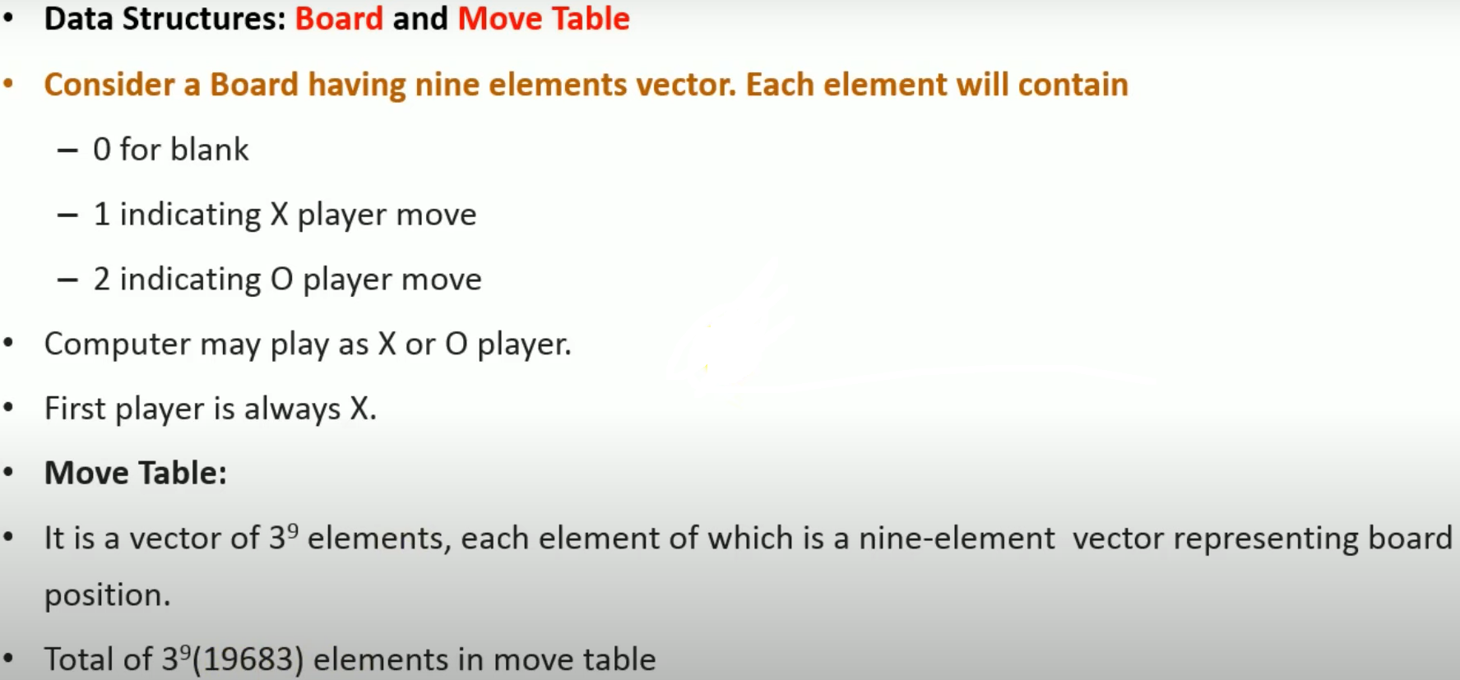
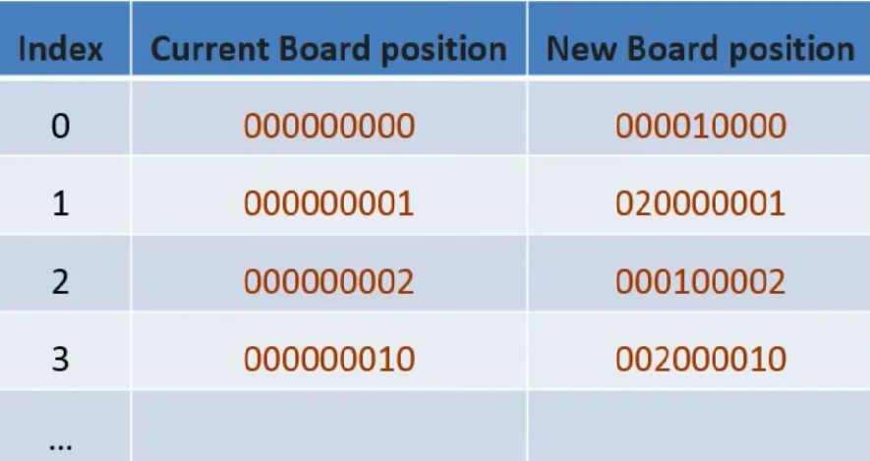

TIC-TAC-TOE GAME PALYING

Slide 10
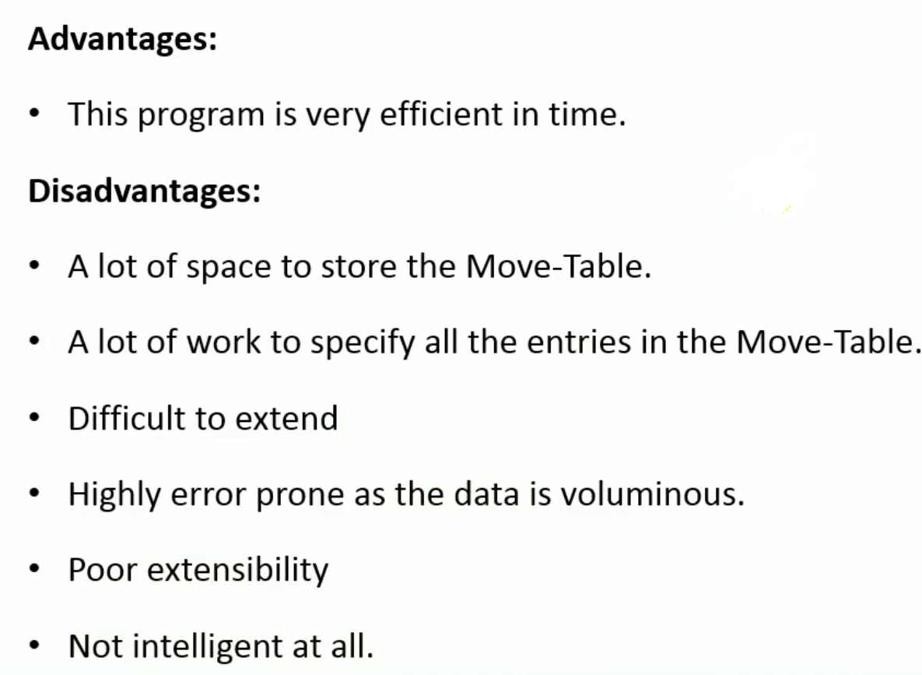
TIC-TAC-TOE GAME PALYING

Slide 11
TIC-TAC-TOE GAME PALYING
8 | 3 | 4
1 | 5 | 9
6 | 7 | 2

Slide 12

Water Jug Problem in Artificial Intelligence – State Space Search
Water Jug Problem Definition:
“You are given two jugs, a 4-litre one and a 3-litre one. Neither has any measuring markers on it. There is a pump that can be used to fill the jugs with water. How can you get exactly 2 liters of water into a 4-litre jug.”

Slide 13
State: (x, y)
where x represents the quantity of water in a 4-liter jug and y represents the quantity of water in a 3-litre jug.
That is, x = 0, 1, 2, 3, or 4 y = 0, 1, 2, 3
Start state: (0, 0).
Goal state: (2, n) for any n<=3
Here need to start from the current state and end up in a goal state.

Slide 14
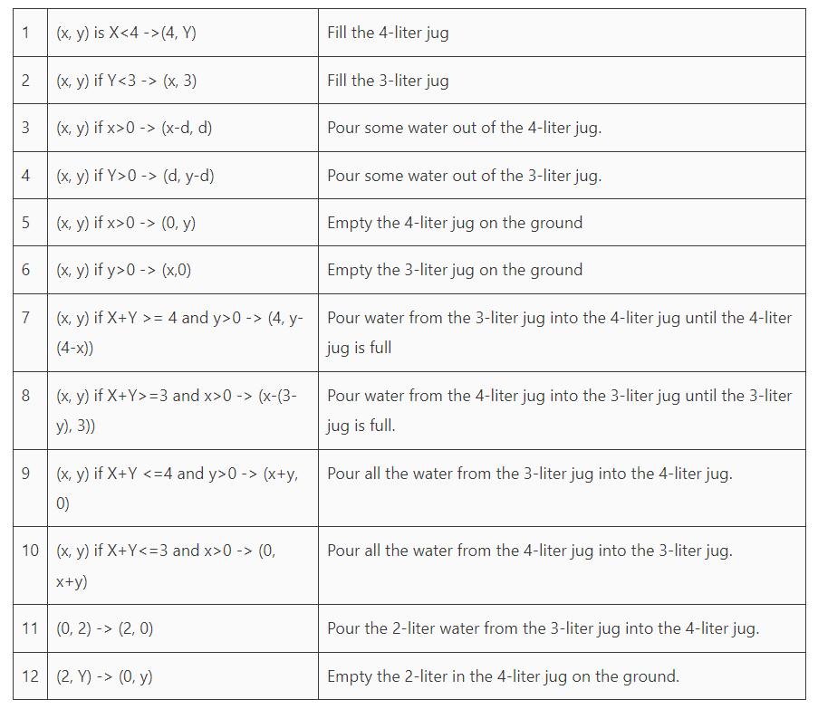
Production Rules for Water Jug Problem

